Slide 1

Lecture 13
-NLP is all about words, their arrangement and their meaning
-NLP is a branch of AI that tries to emulate/understand the way a human speaks to another human
-Lecture 13 is about Word Sense Disambiguation (WSD) and how to achieve WSD by supervised learning
[Ch. 20 of Jurafsky Martin]

Slide 2
WSD – Word Sense Disambiguation
WSD: process of selecting the correct sense of a word
Applications: machine translation, IR, Dialogue-based systems
Input to the WSD algorithm:
-1) the input word with its context (surrounding words)
-2) list of different senses of the word
Output of WSD algorithm
-correct sense of the word

Slide 3
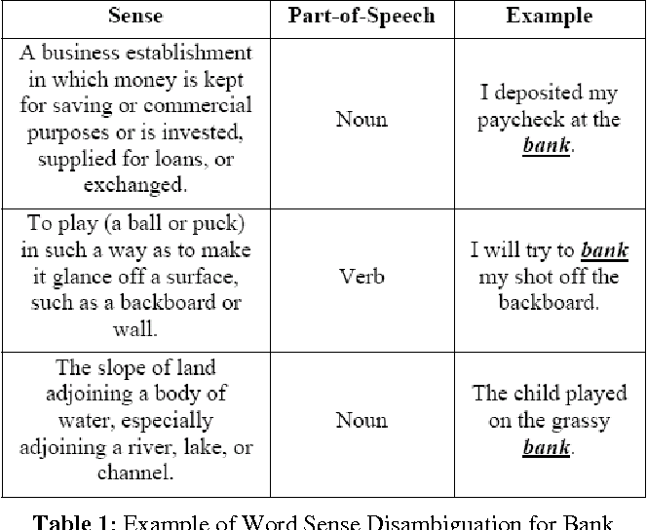
Example of multiple senses of a word (homonyms)
bank

Slide 4
Supervised learning for WSD: FEATURE EXTRACTION
One way of implementing WSD is by supervised learning (covered in these slides).
_{Two types of features for WSD:}
-Collocational features (WINDOW SIZE OF 2 ON EITHER SIDE OF THE WORD) {(w,POS), for all neighboring words w}:
-Co-occurrence features (TOP-12 KEYWORDS):
FISHING, BIG, SOUND, PLAYER, FLY, ROD, POUND, DOUBLE, RUNS, PLAYING, GUITAR, BAND
Part of Speech-
NN1: Singular common noun
CJC: Conjunction
VB: Verb

Slide 5
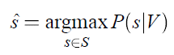
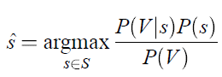
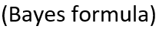
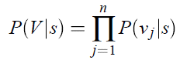
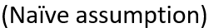
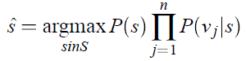
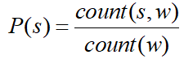
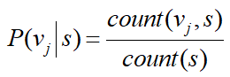
Supervised learning for WSD: CLASSIFIER (Naïve Bayes)
Correct sense

